Slide 1
Data Analytics & Visualization
T.E. AI and DS - Jan 2023
Dr. M. Vijayalakshmi

Slide 2
Module 5 Data analytics and visualization with R
Introduction to R: Data Import and Export, Attribute and Data type, Descriptive statistics.
Exploratory Data Analysis: Visualization before analysis, DirtyData, visualizing single variable, examining Multiple variable
Data Exploration versus presentation

Slide 3


Slide 4
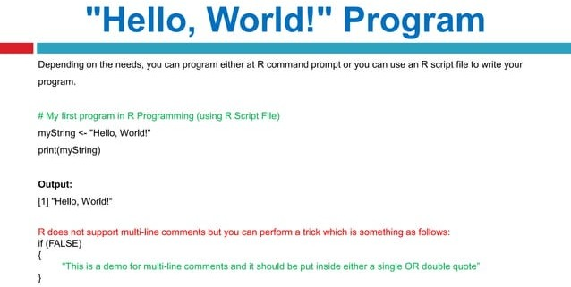

Slide 5
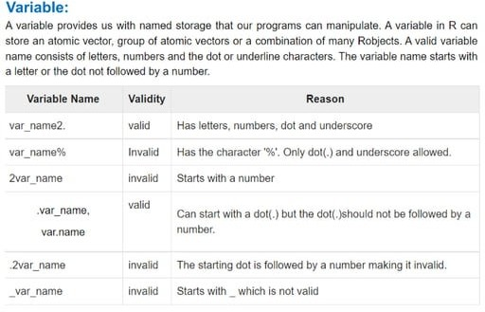

Slide 6
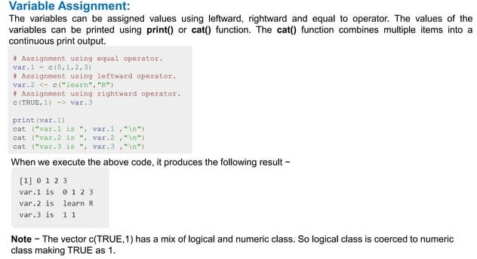

Slide 7
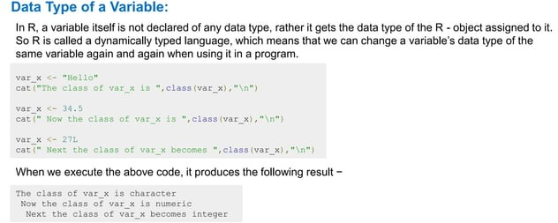

Slide 8
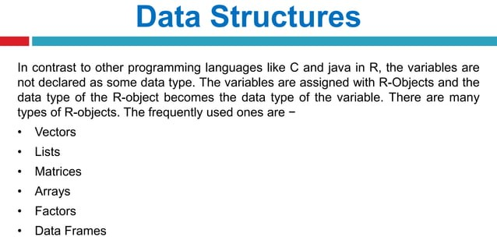

Slide 9
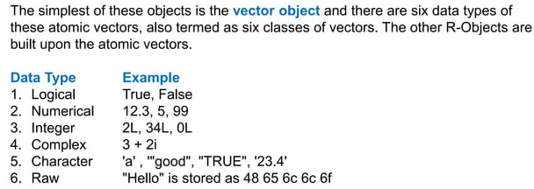

Slide 10
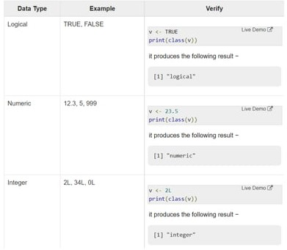

Slide 11
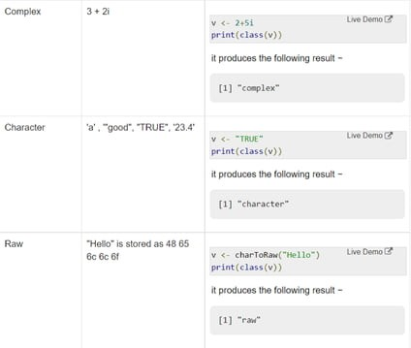

Slide 12
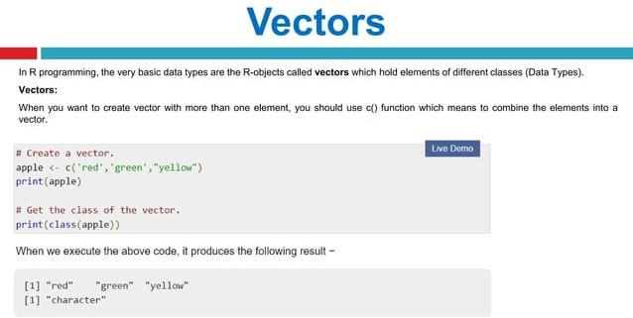

Slide 13
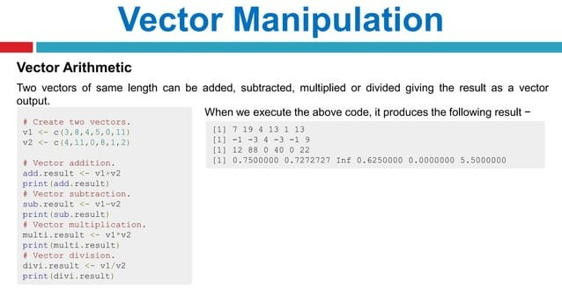

Slide 14
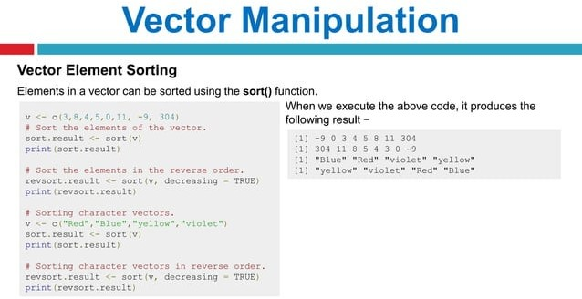

Slide 15
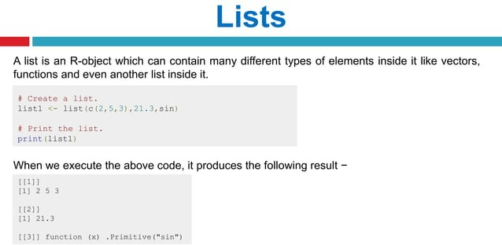

Slide 16
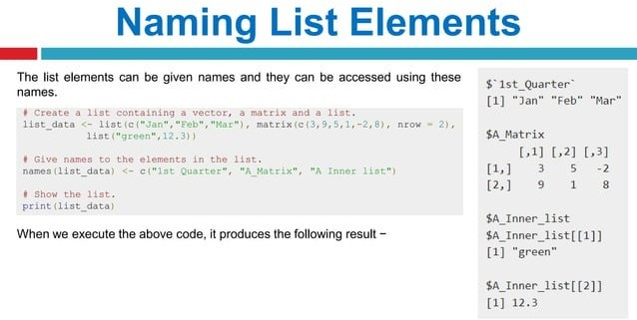

Slide 17
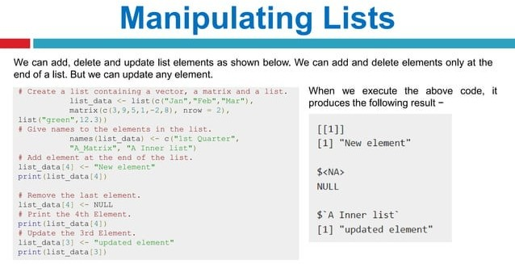

Slide 18
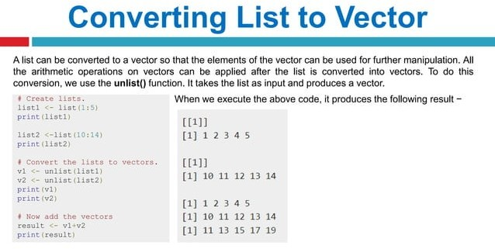

Slide 19
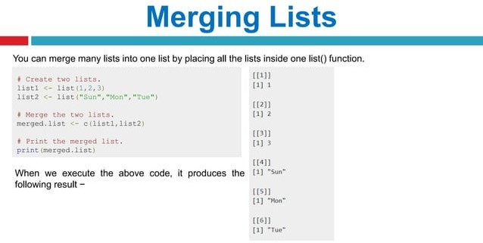

Slide 20
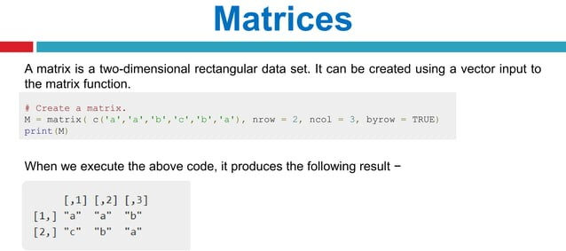

Slide 21
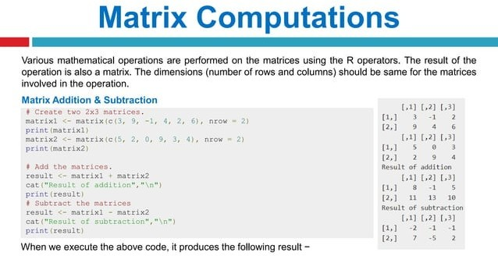

Slide 22
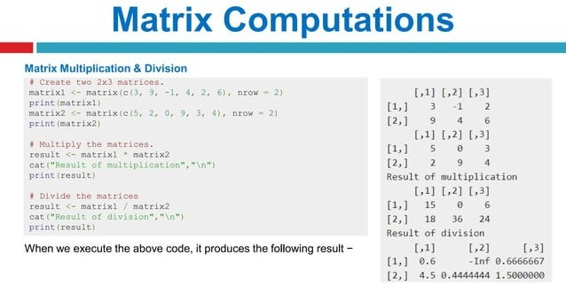

Slide 23
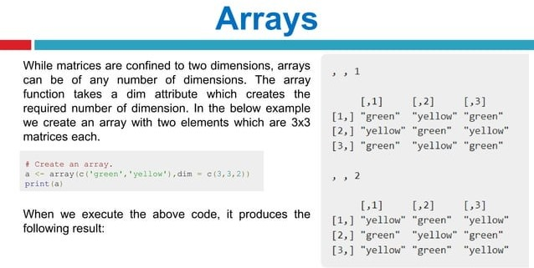

Slide 24
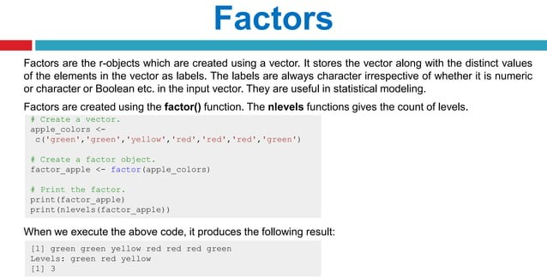

Slide 25
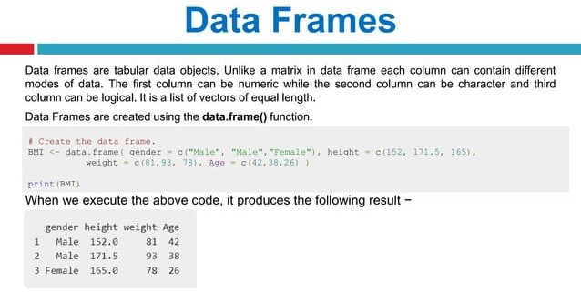

Slide 26
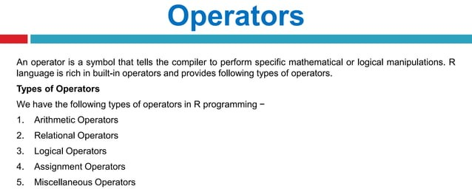

Slide 27
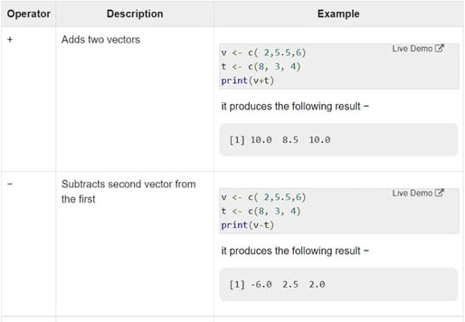

Slide 28
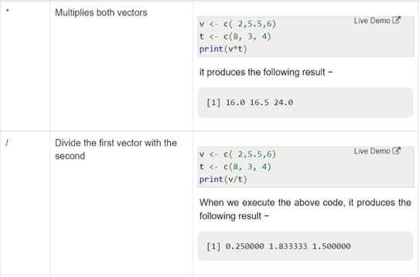

Slide 29
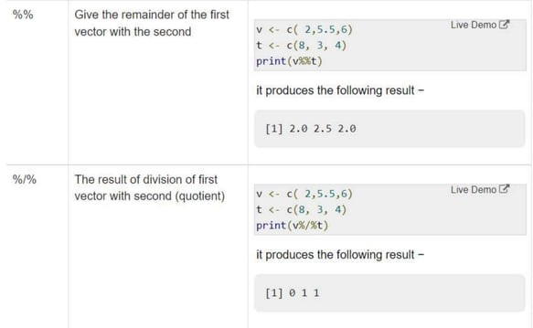

Slide 30
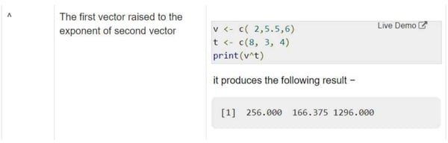

Slide 31
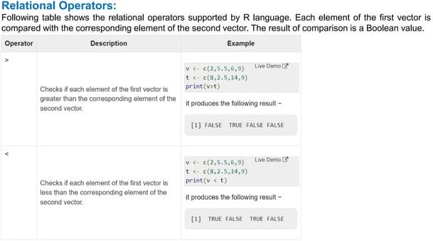

Slide 32
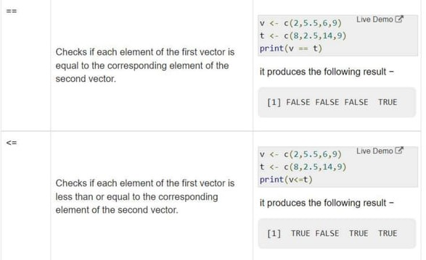

Slide 33
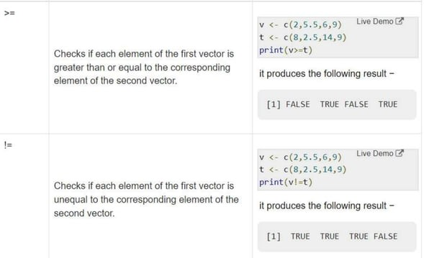

Slide 34
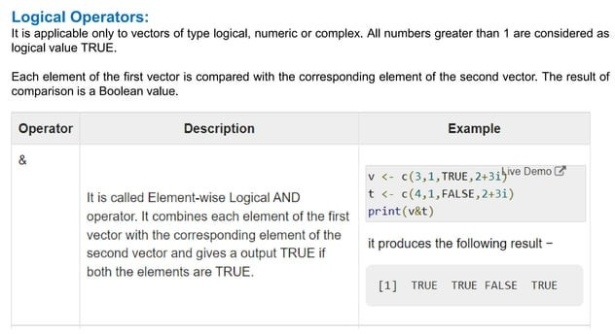

Slide 35
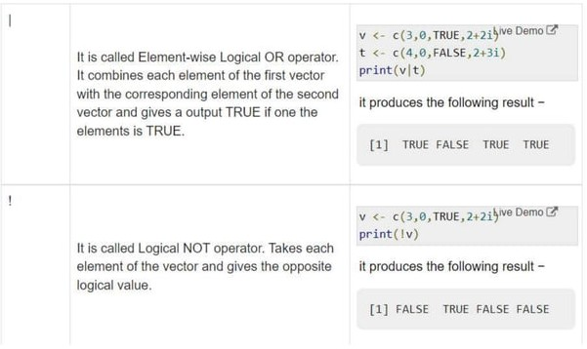

Slide 36
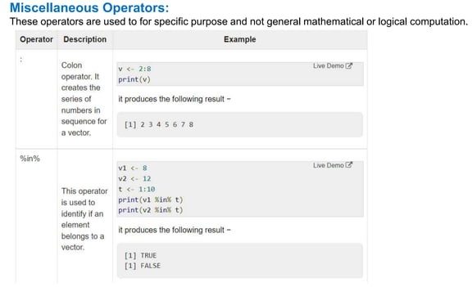

Slide 37
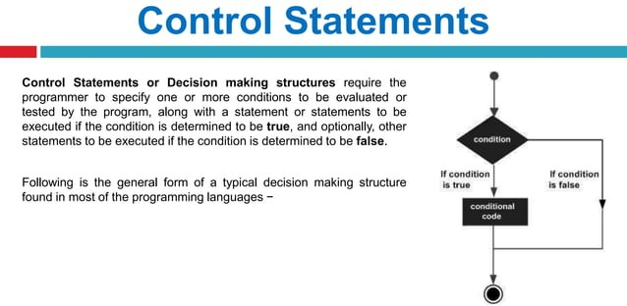

Slide 38
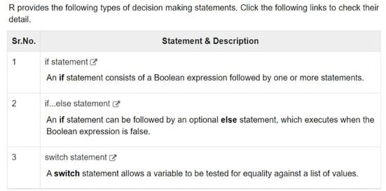

Slide 39
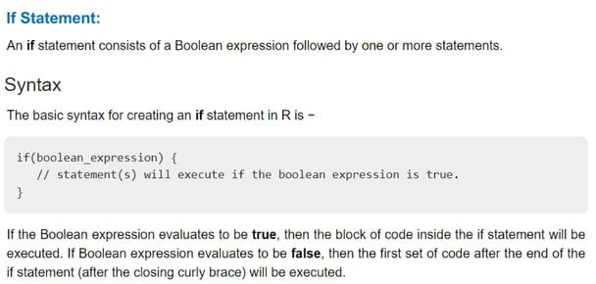

Slide 40
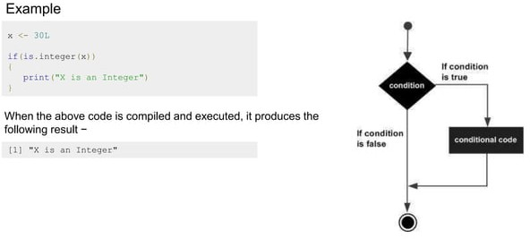

Slide 41
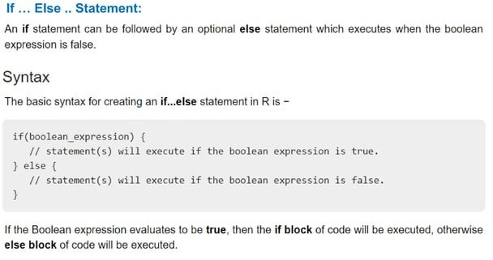

Slide 42
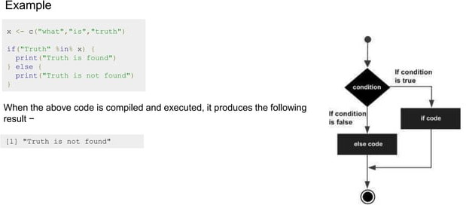

Slide 43
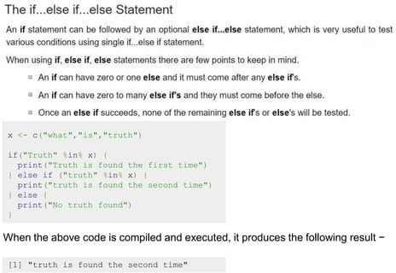

Slide 44
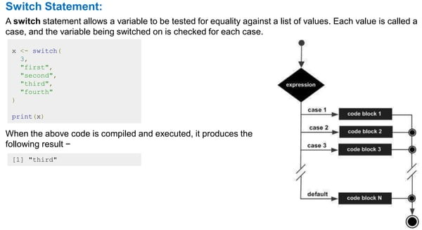

Slide 45
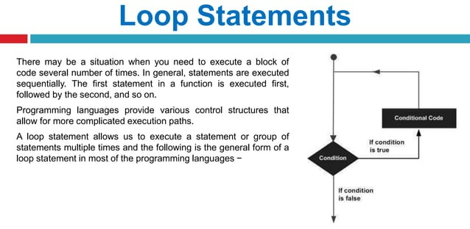

Slide 46
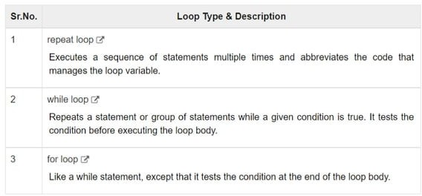

Slide 47
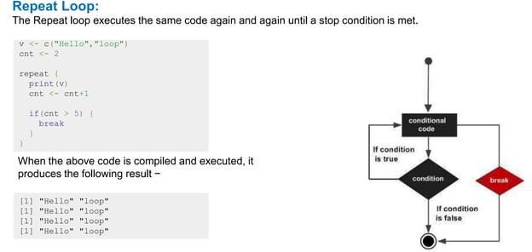

Slide 48
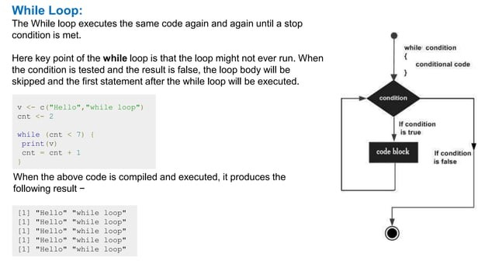

Slide 49
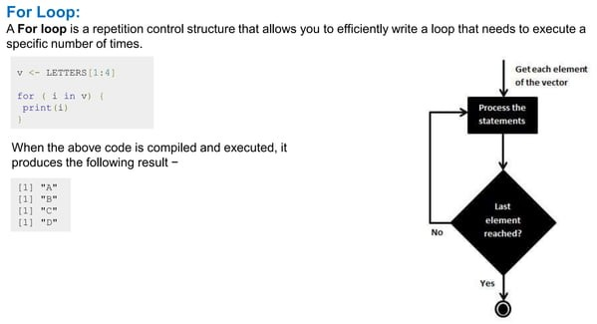

Slide 50
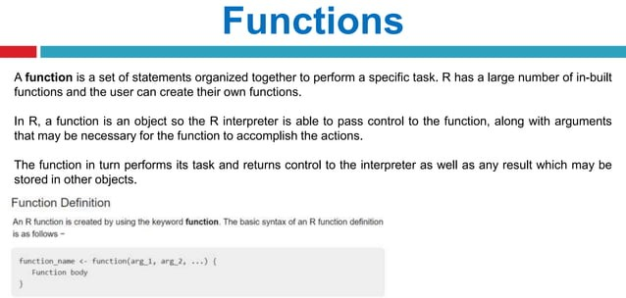

Slide 51
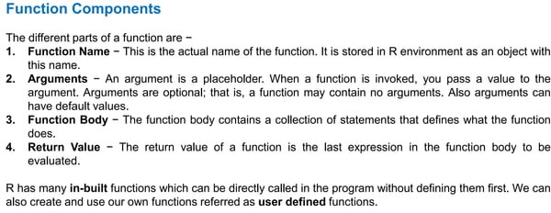

Slide 52
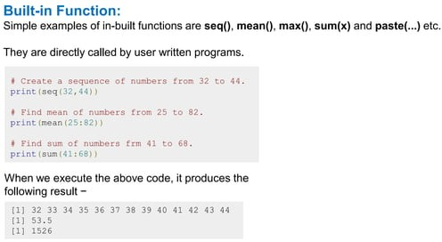

Slide 53
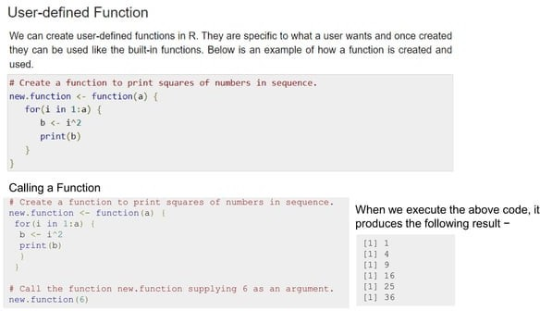

Slide 54


Slide 55


Slide 56


Slide 57


Slide 58


Slide 59


Slide 60


Slide 61


Slide 62


Slide 63


Slide 64
Data Import and Export
Data Types
Importing Data
Keyboard Input
Database Input
Exporting Data
Viewing Data
Variable Labels
Value Labels
Missing Data
Date Values

Slide 65
Data Types
R has a wide variety of data types including scalars, vectors (numerical, character, logical), matrices, dataframes, and lists.

Slide 66
Vectors
a <- c(1,2,5.3,6,-2,4) # numeric vector
b <- c("one","two","three") # character vector
c <- c(TRUE,TRUE,TRUE,FALSE,TRUE,FALSE)
#logical vector
Refer to elements of a vector using subscripts.
a[c(2,4)] # 2nd and 4th elements of vector

Slide 67
Matrices
All columns in a matrix must have the same mode(numeric, character, etc.) and the same length.
The general format is
mymatrix <- matrix(vector, nrow=r, ncol=c, byrow=FALSE,dimnames=list(char_vector_rownames, char_vector_colnames))
byrow=TRUE indicates that the matrix should be filled by rows. byrow=FALSE indicates that the matrix should be filled by columns (the default). dimnames provides optional labels for the columns and rows.

Slide 68
Matrices
# generates 5 x 4 numeric matrix y<-matrix(1:20, nrow=5,ncol=4)
# another example cells <- c(1,26,24,68) rnames <- c("R1", "R2") cnames <- c("C1", "C2") mymatrix <- matrix(cells, nrow=2, ncol=2, byrow=TRUE, dimnames=list(rnames, cnames))
#Identify rows, columns or elements using subscripts.
x[,4] # 4th column of matrix x[3,] # 3rd row of matrix x[2:4,1:3] # rows 2,3,4 of columns 1,2,3

Slide 69
Arrays
Arrays are similar to matrices but can have more than two dimensions. See help(array) for details.

Slide 70
Data frames
A data frame is more general than a matrix, in that different columns can have different modes (numeric, character, factor, etc.).
d <- c(1,2,3,4)
e <- c("red", "white", "red", NA)
f <- c(TRUE,TRUE,TRUE,FALSE)
mydata <- data.frame(d,e,f)
names(mydata) <- c("ID","Color","Passed") #variable names

Slide 71
Data frames
There are a variety of ways to identify the elements of a dataframe .
myframe[3:5] # columns 3,4,5 of dataframe
myframe[c("ID","Age")] # columns ID and Age from dataframe
myframe$X1 # variable x1 in the dataframe

Slide 72
Lists
An ordered collection of objects (components). A list allows you to gather a variety of (possibly unrelated) objects under one name.
# example of a list with 4 components - # a string, a numeric vector, a matrix, and a scaler w <- list(name="Fred", mynumbers=a, mymatrix=y, age=5.3) # example of a list containing two lists v <- c(list1,list2)

Slide 73
Lists
Identify elements of a list using the [[]] convention.
mylist[[2]] # 2nd component of the list

Slide 74
Factors
Tell R that a variable is nominal by making it a factor. The factor stores the nominal values as a vector of integers in the range [ 1... k ] (where k is the number of unique values in the nominal variable), and an internal vector of character strings (the original values) mapped to these integers.
# variable gender with 20 "male" entries and
# 30 "female" entries gender <- c(rep("male",20), rep("female", 30)) gender <- factor(gender)
# stores gender as 20 1s and 30 2s and associates
# 1=female, 2=male internally (alphabetically)
# R now treats gender as a nominal variable summary(gender)

Slide 75
Useful Functions
length(object) # number of elements or components
str(object) # structure of an object
class(object) # class or type of an object
names(object) # names
c(object,object,...) # combine objects into a vector
cbind(object, object, ...) # combine objects as columns
rbind(object, object, ...) # combine objects as rows
ls() # list current objects
rm(object) # delete an object
newobject <- edit(object) # edit copy and save a newobject
fix(object) # edit in place

Slide 76
Importing Data
Importing data into R is fairly simple.
For Stata and Systat, use the foreign package.
For SPSS and SAS the Hmisc package for ease and functionality.
See the Quick-R section on packages, for information on obtaining and installing the these packages.
Example of importing data are provided below.

Slide 77
From A Comma Delimited Text File
# first row contains variable names, comma is separator
# assign the variable id to row names
# note the / instead of \ on mswindows systems mydata <- read.table("c:/mydata.csv", header=TRUE, sep=",", row.names="id")

Slide 78
From Excel
The best way to read an Excel file is to export it to a comma delimited file and import it using the method above.
On windows systems you can use the RODBC package to access Excel files. The first row should contain variable/column names.
# first row contains variable names
# we will read in workSheet mysheet library(RODBC) channel <- odbcConnectExcel("c:/myexel.xls") mydata <- sqlFetch(channel, "mysheet") odbcClose(channel)

Slide 79
From SAS
# save SAS dataset in trasport format libname out xport 'c:/mydata.xpt'; data out.mydata; set sasuser.mydata; run;
library(foreign)
#bsl=read.xport(“mydata.xpt")

Slide 80
Keyboard Input
Usually you will obtain a dataframe by importing it from SAS, SPSS, Excel, Stata, a database, or an ASCII file. To create it interactively, you can do something like the following.
# create a dataframe from scratch age <- c(25, 30, 56) gender <- c("male", "female", "male") weight <- c(160, 110, 220) mydata <- data.frame(age,gender,weight)

Slide 81
Keyboard Input
You can also use R's built in spreadsheet to enter the data interactively, as in the following example.
# enter data using editor mydata <- data.frame(age=numeric(0), gender=character(0), weight=numeric(0)) mydata <- edit(mydata) # note that without the assignment in the line above, # the edits are not saved!

Slide 82
Exporting Data
There are numerous methods for exporting R objects into other formats .
For SPSS, SAS and Stata. you will need to load the foreign packages.
For Excel, you will need the xlsReadWrite package.

Slide 83
Exporting Data
To A Tab Delimited Text File
write.table(mydata, "c:/mydata.txt", sep="\t")
To an Excel Spreadsheet
library(xlsReadWrite) write.xls(mydata, "c:/mydata.xls")
To SAS
library(foreign) write.foreign(mydata, "c:/mydata.txt", "c:/mydata.sas", package="SAS")

Slide 84
Viewing Data
There are a number of functions for listing the contents of an object or dataset.
# list objects in the working environment ls()
# list the variables in mydata names(mydata)
# list the structure of mydata str(mydata)
# list levels of factor v1 in mydata levels(mydata$v1)
# dimensions of an object dim(object)

Slide 85
Viewing Data
There are a number of functions for listing the contents of an object or dataset.
# class of an object (numeric, matrix, dataframe, etc) class(object)
# print mydata mydata
# print first 10 rows of mydata head(mydata, n=10)
# print last 5 rows of mydata tail(mydata, n=5)

Slide 86
Variable Labels
R's ability to handle variable labels is somewhat unsatisfying.
If you use the Hmisc package, you can take advantage of some labeling features.
library(Hmisc) label(mydata$myvar) <- "Variable label for variable myvar" describe(mydata)

Slide 87
Variable Labels
Unfortunately the label is only in effect for functions provided by the Hmisc package, such as describe().
Your other option is to use the variable label as the variable name and then refer to the variable by position index.
names(mydata)[3] <- "This is the label for variable 3" mydata[3] # list the variable

Slide 88
Value Labels
To understand value labels in R, you need to understand the data structure factor.
You can use the factor function to create your own value lables.
# variable v1 is coded 1, 2 or 3
# we want to attach value labels 1=red, 2=blue,3=green mydata$v1 <- factor(mydata$v1, levels = c(1,2,3), labels = c("red", "blue", "green"))
# variable y is coded 1, 3 or 5
# we want to attach value labels 1=Low, 3=Medium, 5=High

Slide 89
Value Labels
mydata$v1 <- ordered(mydata$y, levels = c(1,3, 5), labels = c("Low", "Medium", "High"))
Use the factor() function for nominal data and the ordered() function for ordinal data.
R statistical and graphic functions will then treat the data appropriately.
Note: factor and ordered are used the same way, with the same arguments. The former creates factors and the later creates ordered factors.

Slide 90
Missing Data
In R, missing values are represented by the symbol NA (not available) . Impossible values (e.g., dividing by zero) are represented by the symbol NaN (not a number). Unlike SAS, R uses the same symbol for character and numeric data.
Testing for Missing Values
is.na(x) # returns TRUE of x is missing
y <- c(1,2,3,NA)
is.na(y) # returns a vector (F F F T)

Slide 91
Missing Data
Recoding Values to Missing
# recode 99 to missing for variable v1
# select rows where v1 is 99 and recode column v1
mydata[mydata$v1==99,"v1"] <- NA
Excluding Missing Values from Analyses
Arithmetic functions on missing values yield missing values.
x <- c(1,2,NA,3)
mean(x) # returns NA
mean(x, na.rm=TRUE) # returns 2

Slide 92
Missing Data
The function complete.cases() returns a logical vector indicating which cases are complete.
# list rows of data that have missing values mydata[!complete.cases(mydata),]
The function na.omit() returns the object with listwise deletion of missing values.
# create new dataset without missing data newdata <- na.omit(mydata)

Slide 93
Date Values
Dates are represented as the number of days since 1970-01-01, with negative values for earlier dates.
# use as.Date( ) to convert strings to dates
mydates <- as.Date(c("2007-06-22", "2004-02-13"))
# number of days between 6/22/07 and 2/13/04 days <- mydates[1] - mydates[2]
Sys.Date( ) returns today's date.
Date() returns the current date and time.

Slide 94
Date Values
The following symbols can be used with the format( ) function to print dates.
Symbol | Meaning | Example
%d | day as a number (0-31) | 01-31
%a %A | abbreviated weekday unabbreviated weekday | Mon Monday
%m | month (00-12) | 00-12
%b %B | abbreviated month unabbreviated month | Jan January
%y %Y | 2-digit year 4-digit year | 07 2007

Slide 95
Date Values
# print today's date
today <- Sys.Date()
format(today, format="%B %d %Y") "June 20 2007"

Slide 96

Exploratory Data Analysis Scatterplots show possible relationships
x <- rnorm(50) # default is mean=0, sd=1
y <- x + rnorm(50, mean=0, sd=0.5)
plot(y,x)

Slide 97

Visualization before Analysis Anscombe’s quartet – 4 datasets, same statistics
should be x

Slide 98

Visualization before Analysis Anscombe’s quartet – visualized

Slide 99
Visualization before Analysis Anscombe’s quartet – Rstudio exercise
)
Enter and plot Anscombe’s dataset #3
and obtain the linear regression line
x <- 4:14
x
y <- c(5.39,5.73,6.08,6.42,6.77,7.11,7.46,7.81,8.15,12.74,8.84)
y
summary(x)
var(x)
summary(y)
var(y)
plot(y~x)
lm(y~x)

Slide 100

Dirty Data Age Distribution of bank account holders
What is wrong here?

Slide 101

Dirty Data - Age of Mortgage
What is wrong here?

Slide 102

Visualizing a Single Variable Example Visualization Functions

Slide 103

Visualizing a Single Variable Dotchart – MPG of Car Models

Slide 104

Visualizing a Single Variable Barplot – Distribution of Car Cylinder Counts

Slide 105

Visualizing a Single Variable Histogram – Income

Slide 106

Visualizing a Single Variable Density – Income (log10 scale)

Slide 107
Visualizing a Single Variable Density – Income (log10 scale)
In this case, the log density plot emphasizes the log nature of the distribution
The rug() function at the bottom creates a one-dimensional density plot to emphasize the distribution

Slide 108

Visualizing a Single Variable Density plots – Diamond prices, log of same

Slide 109

Examining Multiple Variables Examining two variables with regression
Red line = linear regression
Blue line = LOESS curve fit
x

Slide 110

Examining Multiple Variables Dotchart: MPG of car models grouped by cylinder

Slide 111

Examining Multiple Variables Barplot: visualize multiple variables

Slide 112

Examining Multiple Variables Box-and-whisker plot: income versus region
Box contains central 50% of data
Line inside box is median value
Shows data quartiles

Slide 113

Examining Multiple Variables Scatterplot (a) & Hexbinplot – income vs education
The hexbinplot combines the ideas of scatterplot and histogram
For high volume data hexbinplot may be better than scatterplot

Slide 114

Examining Multiple Variables Variable over time – airline passenger counts

Slide 115

Examining Multiple Variables Matrix of Scatterplots

Slide 116
Exploration vs Presentation
Data visualization for data exploration is different from presenting results to stakeholders
Data scientists prefer graphs that are technical in nature
Nontechnical stakeholders prefer simple, clear graphics that focus on the message rather than the data

Slide 117

Exploration vs Presentation Density plots better for data scientists

Slide 118

Exploration vs Presentation Histograms better to show stakeholders

